Slide 1
Growth & Allocation
March 19, 2019

Slide 2
Spicoli question of the day: Why do plants grow?

Slide 3
Allocation

Slide 4
Allocation
The distribution of growth to different organs
Allometry: the relative size of different organs
High leaf allocation
High stem allocation

Slide 5
Following the carbon

Slide 6
CO₂
Carbon is first taken up by photosynthesis (source)

Slide 7
The sugars are then transported throughout the plant (sinks)

Slide 8
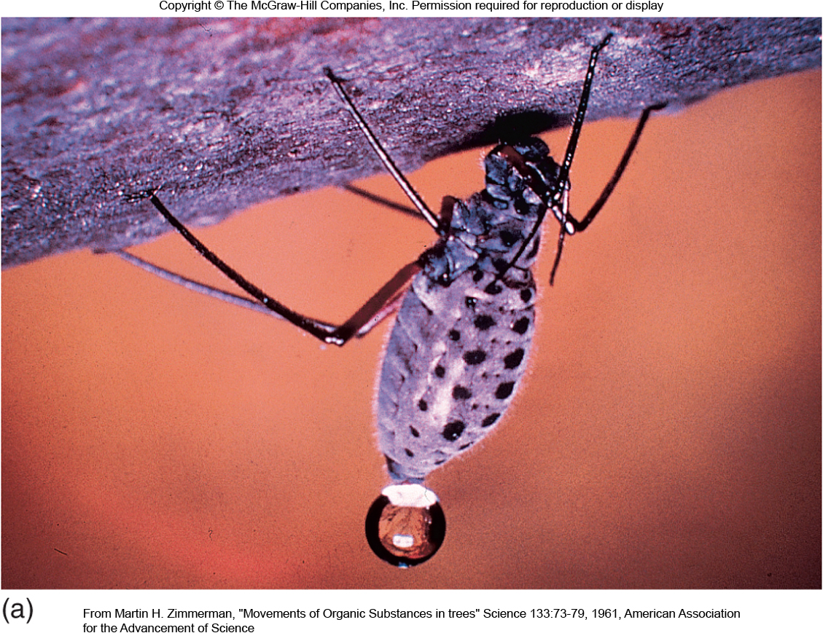
Translocation
Movement of food substances through the plant (via water)
Translocation happens fast!
(Can’t be accounted for by diffusion alone)

Slide 9
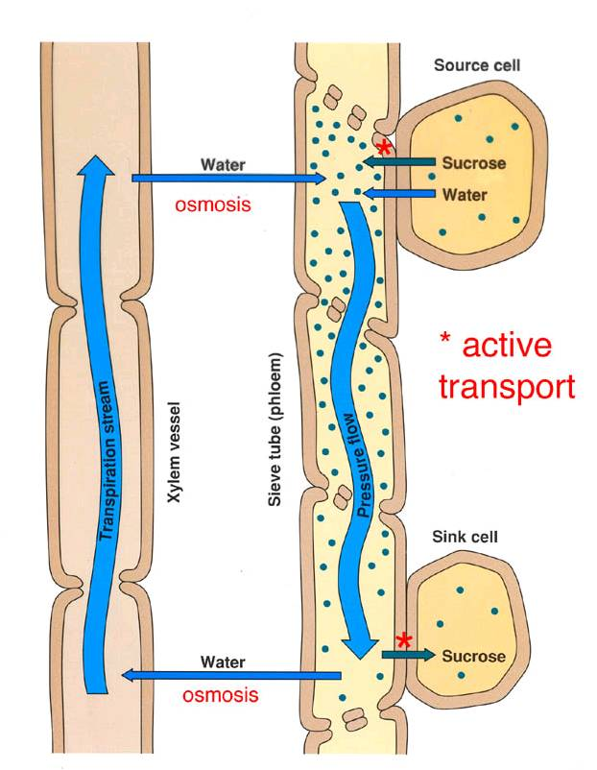
Pressure-flow hypothesis
Food is actively loaded into phloem from “source”
Water enters phloem from xylem via osmosis
Pressure gradient drives food to “sink”
Food is actively removed from sink

Slide 10
What does the carbon get used for? (What are the sinks?)

Slide 11
In isolation, how would abiotic conditions influence allocation?
Light
Temperature
Water
CO₂
Nutrients
NASA

Slide 12
In isolation, how would life history traits influence allocation?
Lifespan
Ontogeny
Photosynthetic pathway
Microbial symbiosis

Slide 13
Class activity: the Invader
Pretend you are a species of plant
Pick your dream place to live/invade
What growth and reproductive strategy will you adopt?
Things to think about:
What is the environment like?
Natural enemies?
Competitors?
What kind of flowers/seeds?

Slide 14
Source/sink controversy

Slide 15


Slide 16
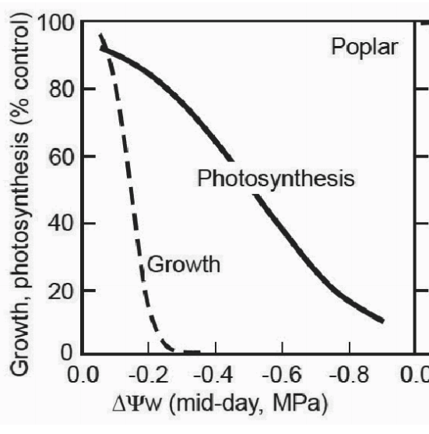
Water availability constrains growth more than photosynthesis
Körner (2003)

Slide 17
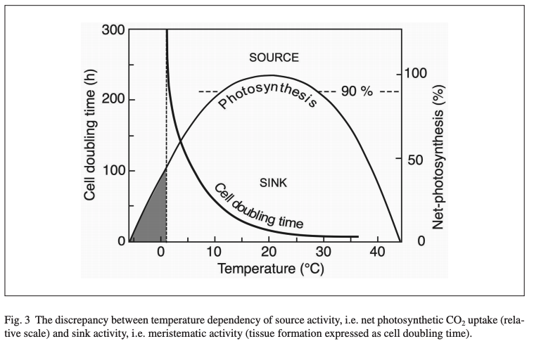
Low temperature constrains growth more than photosynthesis
Körner (2003)

Slide 18
Overarching thesis – photosynthesis matches sink strength

Slide 19
Overarching thesis – photosynthesis matches sink strength
How could you test this??

Slide 20
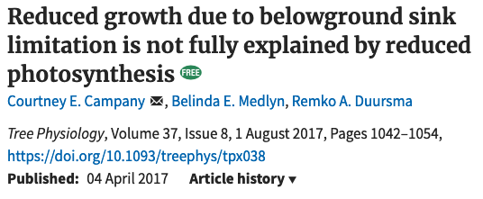

Slide 21
Plant growth decreased by 84%
Campany et al. (2017)

Slide 22
Allocation was similar
Campany et al. (2017)

Slide 23
Photosynthesis only decreased by 26%, but there was a big change in carbon use efficiency
Campany et al. (2017)

Slide 24
Conclusion: sink strength does influence photosynthesis, but this does not fully explain sink-limited growth reductions

Slide 25
Some things that need considered
Photosynthetic acclimation
Whole-plant- versus leaf-level photosynthesis
Within-leaf and whole-plant allocation of nutrients

